Slide 1
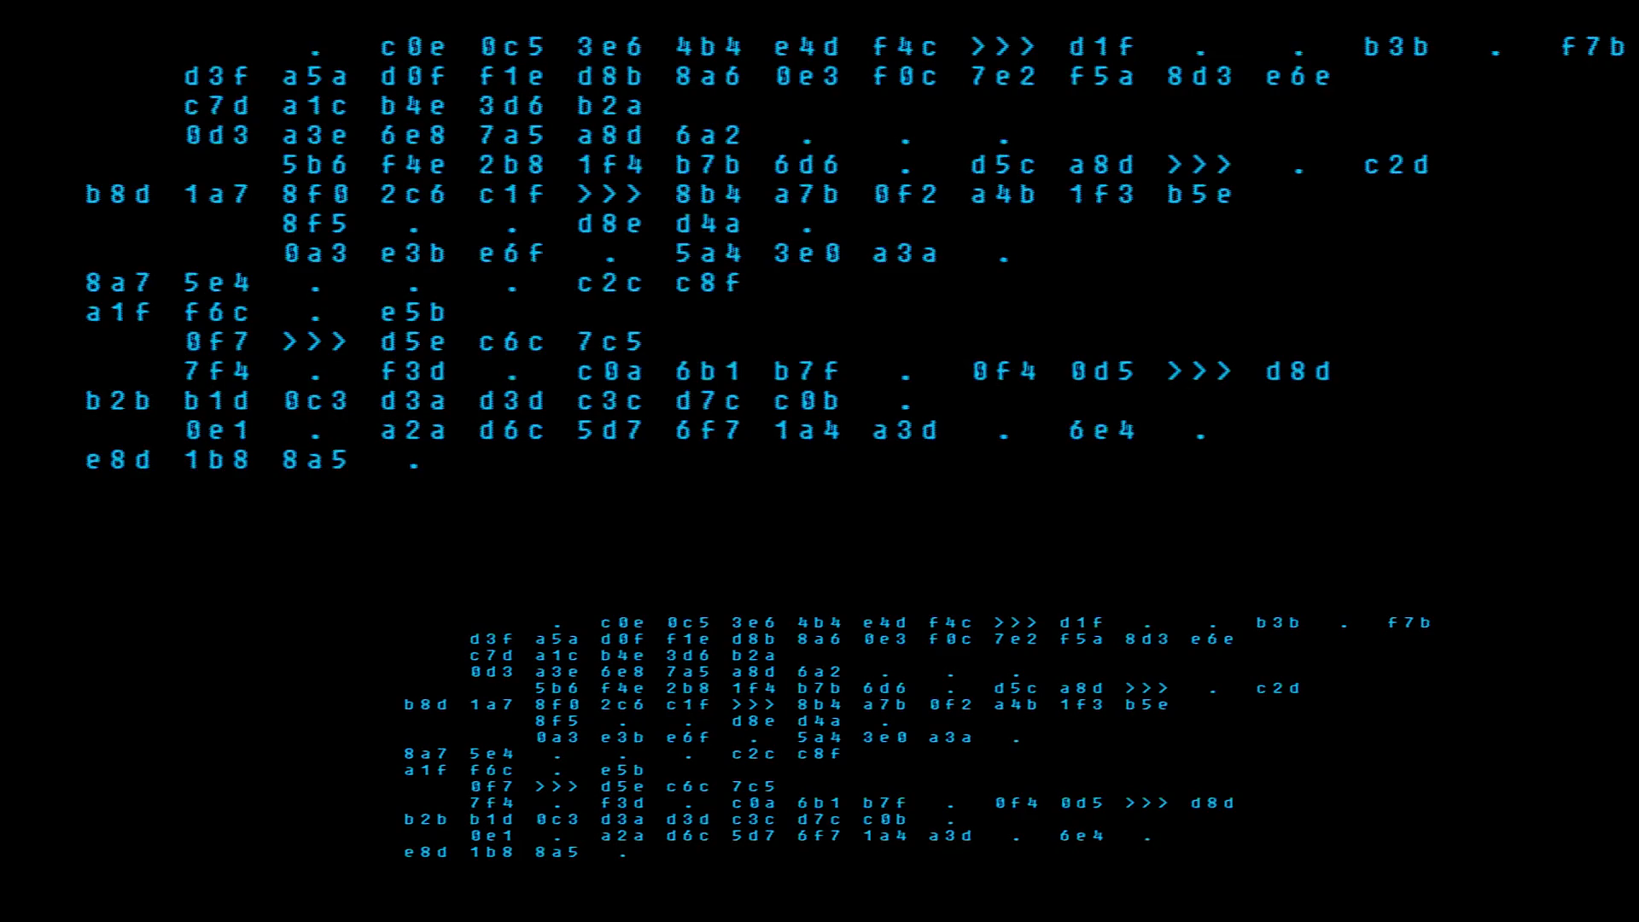
Developing for F&O Using Git

Slide 2
Developing for F&O Using Git

Slide 3


Nathan Clouse
Microsoft Business Applications MVP
Technical Architect enVista Corp.
Microsoft Business Applications MVP nclouse@envistacorp.com www.atomicax.com
www.dynamics.fo
@NathanClouseAX

Slide 4


Overview
Package Management
Lifecycle of a Branch
Developing and working with Git
GitHub
Pull Requests
YAML
Key Differences
Demo
Branching
Questions

Slide 5
Package Management
1 Package
Multiple Packages
Only 1 package ever
As a version-controlled sub folder of PackagesLocalDirectory
Easy to Manage, Easy to setup
Rigid – can only have that 1 package in your repo
Can do multiple Repo’s for Multiple Packages
Any number of packages
PackagesLocalDirectory is under source control (or similar)
Easy to manage, difficult to setup *
Fluid – can do whatever you like
Source packages
Compiled packages
1 repo for all folders under PackageLocalDirectory

Slide 6
Lifecycle of a branch
Tech Lead / Sr. Developer
Developer
Create a work item
Confirm / verify work item
Create branch
Assign work item to Dev
Review and accept PR
Get Work
Do Work
Commit Work
Create PR

Slide 7
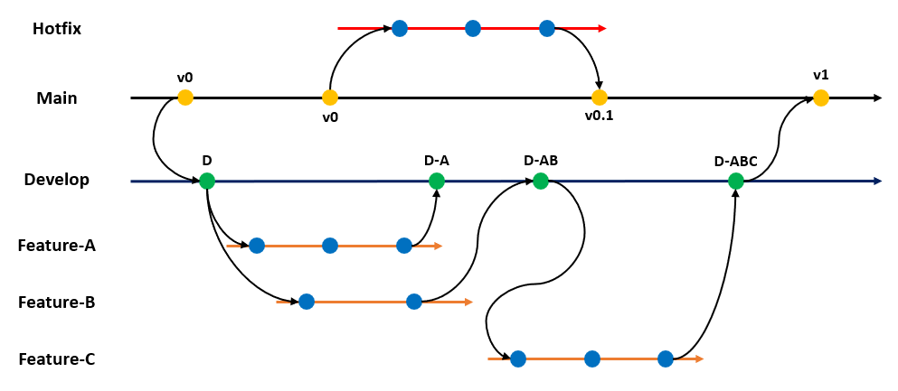
Time

Slide 8
Working in Visual Studio
VS 2017 / 2019
Get work
Get Branch
Do work
Test work
Commit Work (at any time)
Get continuous integration feedback
(re-test work)
(re-do work)
Create PR

Slide 9
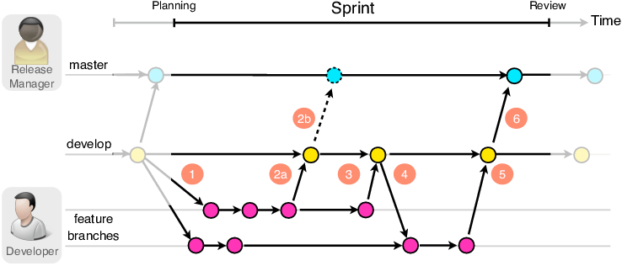

Slide 10
GitHub
Can I use GitHub? Yes!
Should I use GitHub? Well….
Not Supported
No documentation
Build story not complete
Release story not complete
Lots of other unknowns
Azure DevOps is for Enterprise *
GitHub is (largely) for community *

Slide 11
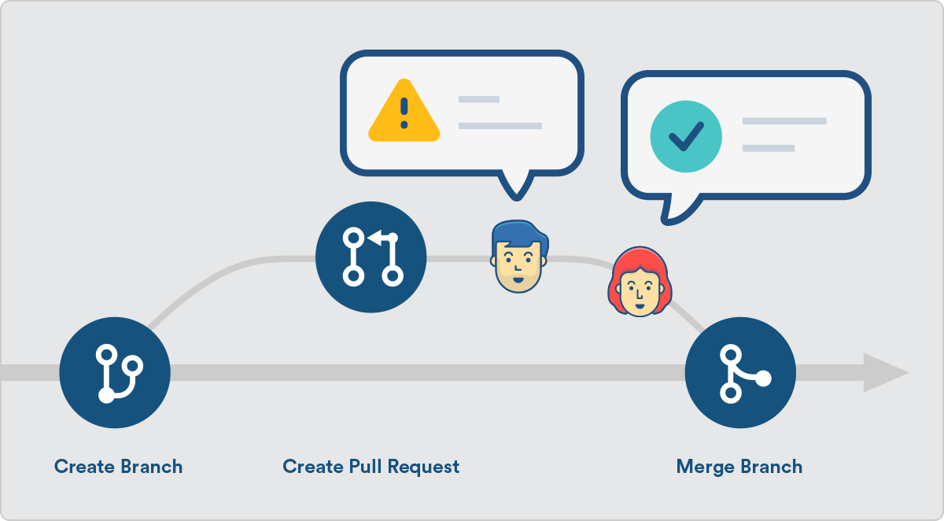
Pull Request (PR)
What is a PR?
Who creates them?
Who reviews them?
What verifies them?
What merges them?
Who approves them?
Notes:
eady to begin the process of merging new code changes with the main project repository

Slide 12
Pull Request (PR)
Review
Approve
Notes:
Review bp logs, car report, RSAT and atl results

Slide 13
Pull Request (PR)
What is a PR?
Who creates them?
Who reviews them?
What verifies them?
What merges them?

Slide 14


Slide 15

Yet Another Markup Language? YAML Ain't Markup Language
What is YAML?
What can it do?
Examples
Build on commit
Build on PR
Test on PR
Schedule
Notes:
Yaml is a human-readable data-serialization language. It is commonly used for configuration files and in applications

Slide 16
Key Differences
TFVC
Git
But it’s supported
Push based
Branches last nearly forever
Monolithic
Not Supported
Modern
Pull based
Branches are short lived
Change in thinking
Will be out of your comfort zone if you’ve only ever used TFVC

Slide 17

DEMO

Slide 19
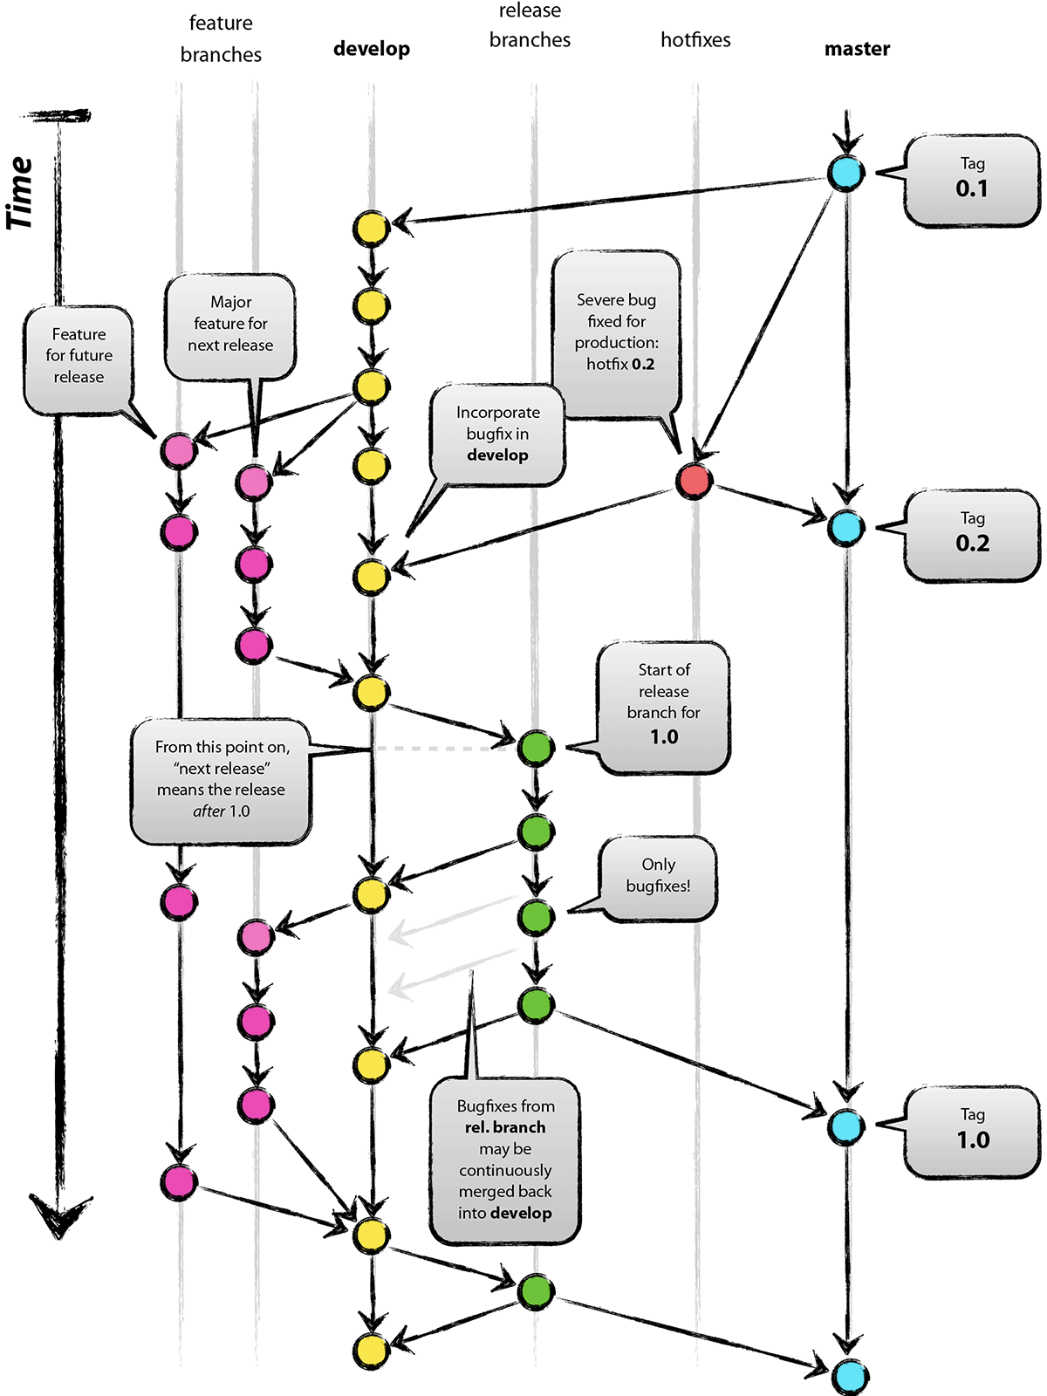

Slide 20
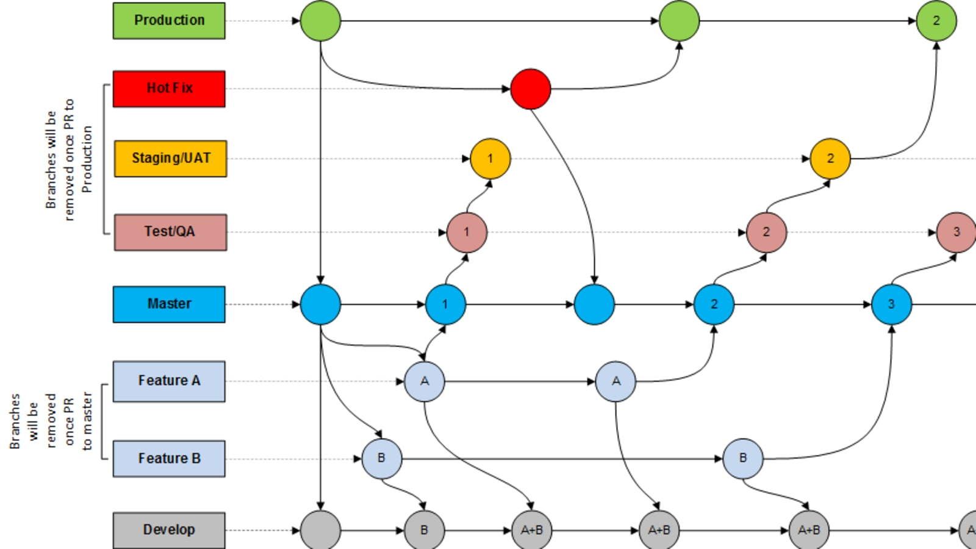

Slide 21
Questions?

Slide 22
Sources
http://www.atomicax.com/article/giting-started-git-d365fo-and-other-puns
http://www.atomicax.com/article/getting-started-gated-checkins
http://www.atomicax.com/article/moving-tfvc-git-azdo
http://www.atomicax.com/article/getting-started-tfvc-and-d365fo
http://www.atomicax.com/article/why-gated-check-ins-are-awesome
http://www.atomicax.com/article/staging-and-git
http://www.atomicax.com/content/git-alm-field-guide

Slide 23
Nathan Clouse
Microsoft Business Applications MVP
Technical Architect enVista Corp.
Microsoft Business Applications MVP nclouse@envistacorp.com www.atomicax.com
www.dynamics.fo
@NathanClouseAX

Slide 24


